Slide 1
CFA Model Revision
Byrne Chapter 4
Brown Chapter 5

Slide 2
CFA: Thoughts
CFA is a confirmatory procedure
Traditional:
Create your scale
Test with EFA
Test again with CFA
(or split half)

Slide 3
CFA: Thoughts
Scale development now:
Often you need to do the EFA and CFA in the same paper for new scale development
If you have an established scale, skip the EFA and go to CFA*
* Depends on the reviewer

Slide 4
Why might CFA be bad?
Number of factors
If you do the EFA first, this reason is less likely to happen.
Method effects
The way you asked the question influences the items
I worry all the time … I never worry at all.
Be careful of reverse scored items.

Slide 5
Why might CFA be bad?
Number of factors
When you correlate errors – consider:
Is it the wording of the item?
Or are you missing a factor?
There’s no way to tell from the SEM output.

Slide 6
Why might CFA be bad?
Number of factors
Too many factors will be seen with high latent-latent correlations
If the correlation is close to 1, consider collapsing them into one factor

Slide 7
Why might CFA be bad?
Indicators and factor loadings
One item might want to load on a different factor
One item might want to cross load onto two factors or more
One item might not load at all

Slide 8
Why might CFA be bad?
Improper solutions/nonpositive definite matrices
Remember improper solutions = Heywood, implausible parameter estimates
Nonpositive definite matrices occur when things are too correlated

Slide 9
Why might CFA be bad?
How can I test?
You can run a PCA (whoa!)
If all the eigenvalues are over zero, then you have a positive definite matrix.

Slide 10
Why might CFA be bad?
Solutions:
Run bivariate correlations and figure out which variables are too highly correlated
Combine or drop one of them.
Lots of filled in missing data will be a problem here.
If everything is highly correlated, one low correlation will give you problems

Slide 11
Why might CFA be bad?
Solutions:
More subjects ☹
Eliminate outliers

Slide 12
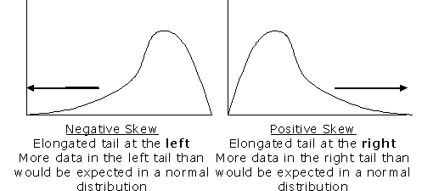
Normality
Skewness affects the means of the measured variables → affects means of latents

Slide 13
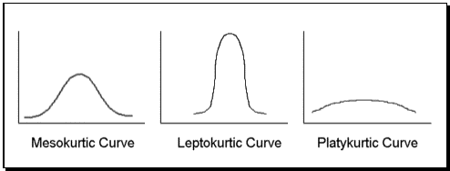
Normality
Kurtosis affects tests with variance/covariance (so all of SEM).

Slide 14
Normality
Normally we check these statistics using residual values in SPSS
We can check in Amos!
Analysis properties > output > tests for normality and outliers

Slide 15
Normality
For kurtosis > values over 7 are problematic
Positive numbers indicate peaked distributions, that don’t have enough variance
Negative numbers indicate flat distributions that have too much variance
Check these values under Kurtosis (not CR)

Slide 16
Normality
Multivariate normality (aka no skew/kurtosis)
Look at the last line of the normality/outliers window.
You are looking at the CR in this column.
Values greater than 5 are bad.

Slide 17
What to do?
If the normality is bad you can:
Use ADF, but only tends to work with very large samples (10 times parameters estimated, 1000-5000 people)
Use Satorra-Bentler X² correction (which Amos won’t do)

Slide 18
Outliers
The output for the outliers is the same idea of what we do in our normal data screening procedures
You get Mahalanobis distance and pvalues.
Remember that .000 is bad.
Observation number is the line number.

Slide 19
Outliers
You can also just look for a big jump in the D statistics
Kind of like the “big drop” for the EFA statistics on a scree plot.

Slide 20
Model Revision
You can use modification indices to determine what to do with the model
Correlated error terms may be appropriate for very similar type items.
You can try double loadings – but you may get pushback from the naysayers of traditional one-and-one-only loading people.

Slide 21
Let’s Try It
MBI
Maslach Burnout Inventory
MBI data 1.txt
MBI data 2.sav

Slide 22
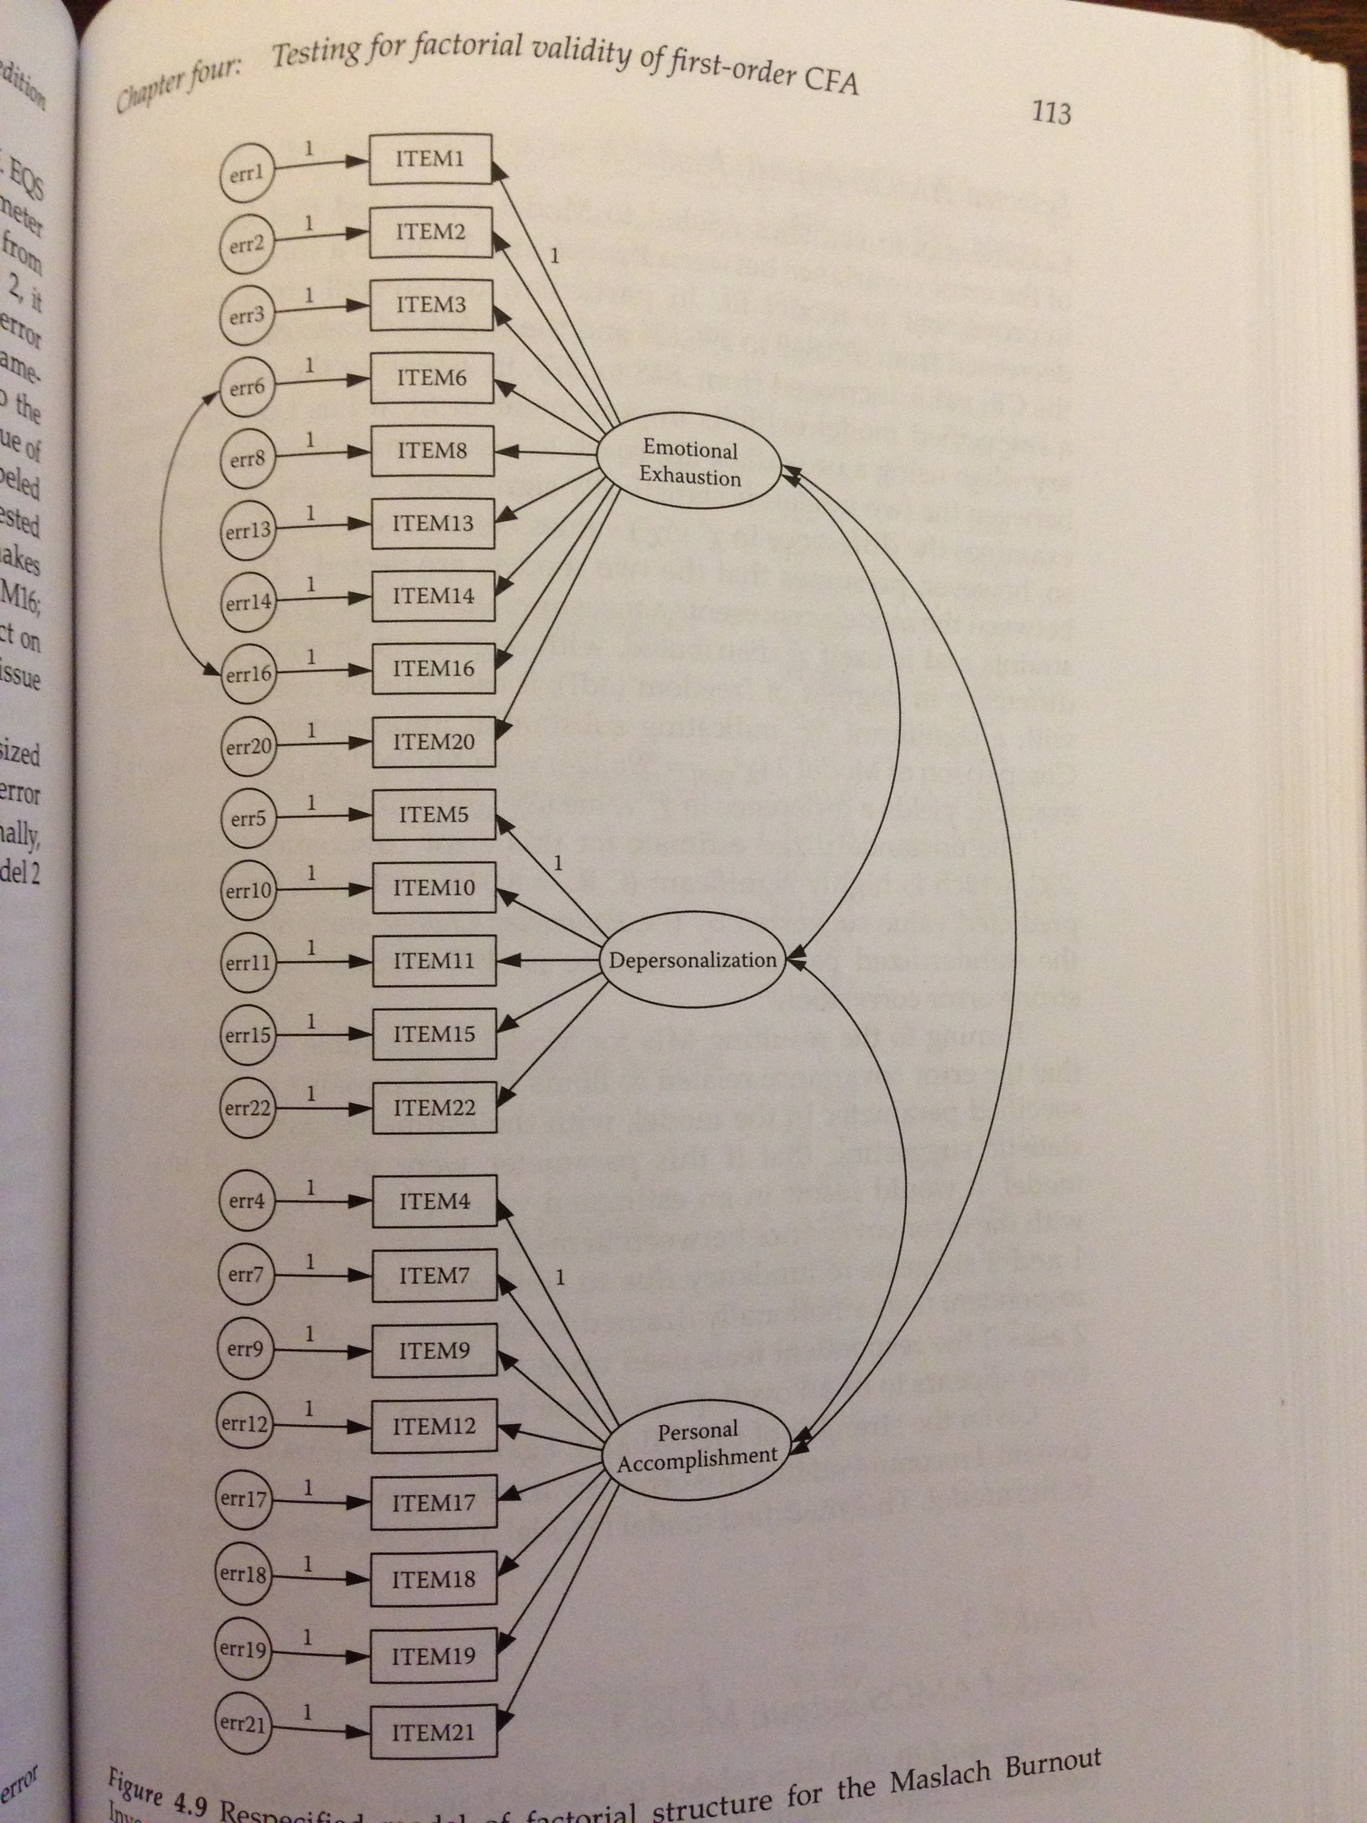

Slide 23
Let’s Try It!
I usually manage one way or another.
I feel proud that I have accomplished things in life.
I usually take things in stride.
I am friends with myself.
I feel that I can handle many things at a time.
I am determined.
I can get through difficult times because I’ve experienced difficulty before.
I have self-discipline.
I keep interested in things.
I can usually find something to laugh about.
My belief in myself gets me through hard times.
In an emergency, I’m someone people can generally rely on.
My life has meaning.
When I’m in a difficult situation, I can usually find my way out of it.
RS14

Slide 24
Let’s Try It
1-factor model
2-factor model
F1: 1, 3, 5, 7, 11, 12, 14
F2: 2, 4, 6, 8, 9, 10, 13

